Slide 1
GSE130613 – Gad Asher Hypoxia 3’ MARS-seq x Nanopore
15/06/2026 to 21/07/2026

Slide 2
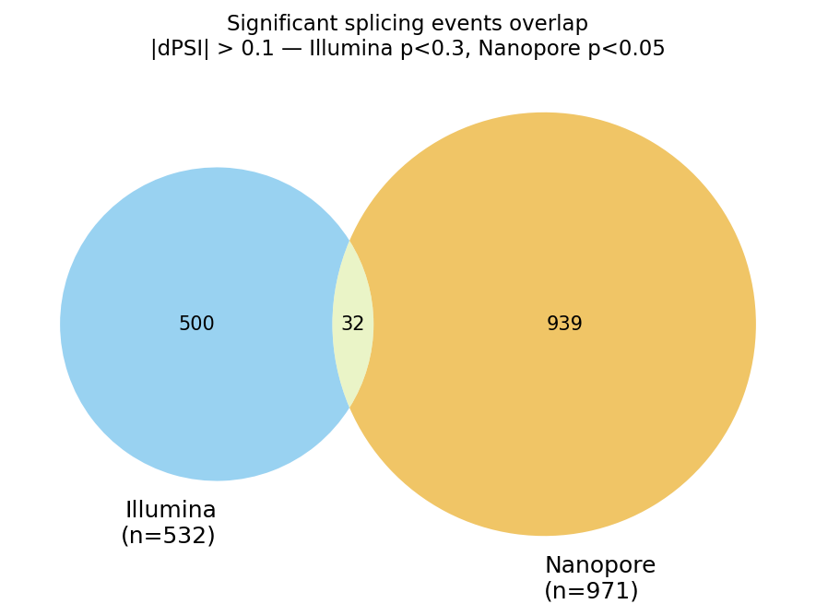
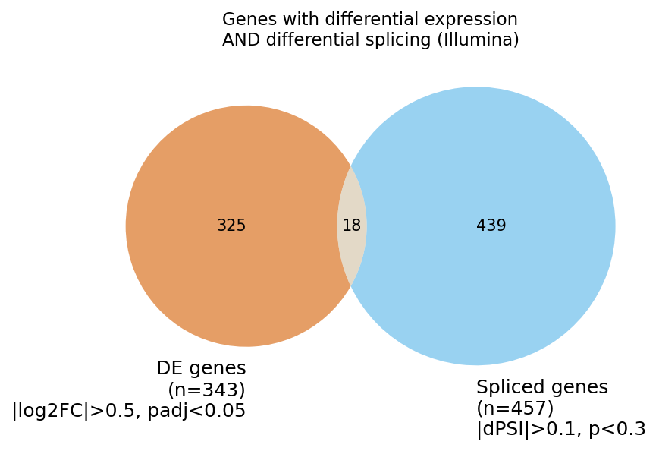
Baseline — original Salmon pipeline
OLD pipeline
BEFORE trimming

Slide 3
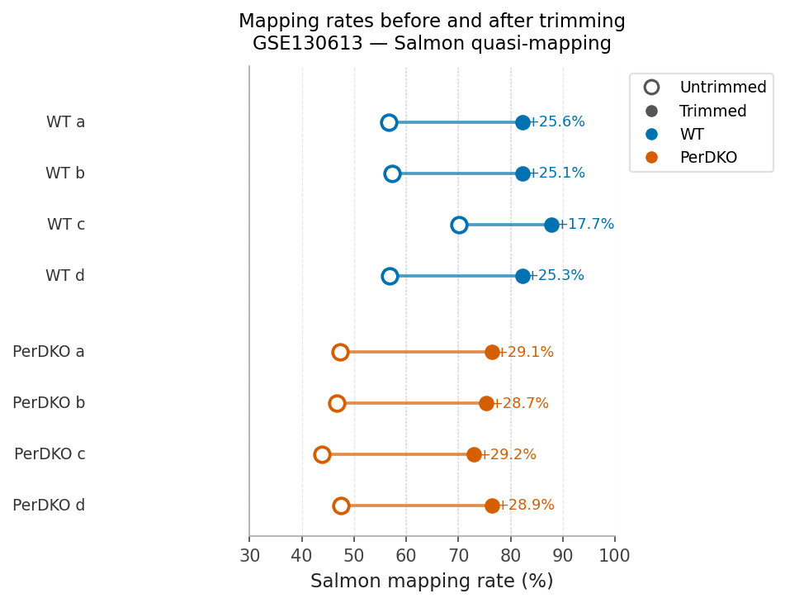
Baseline — original Salmon pipeline
OLD pipeline
AFTER trimming

Slide 4
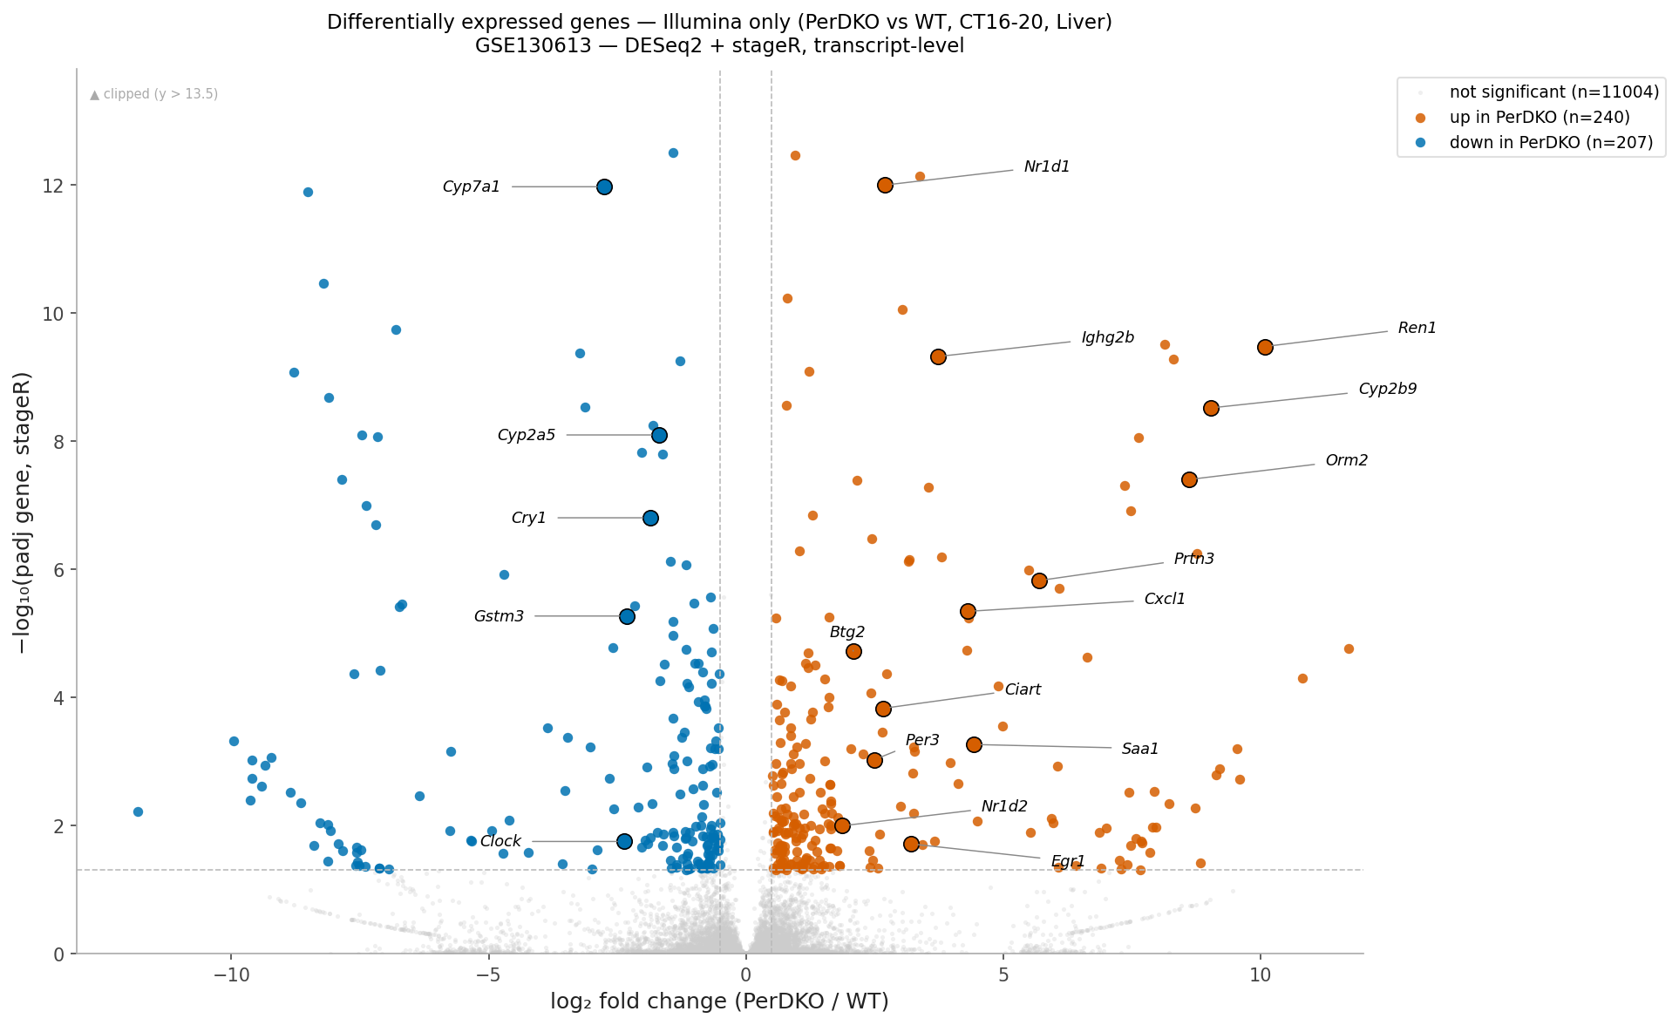
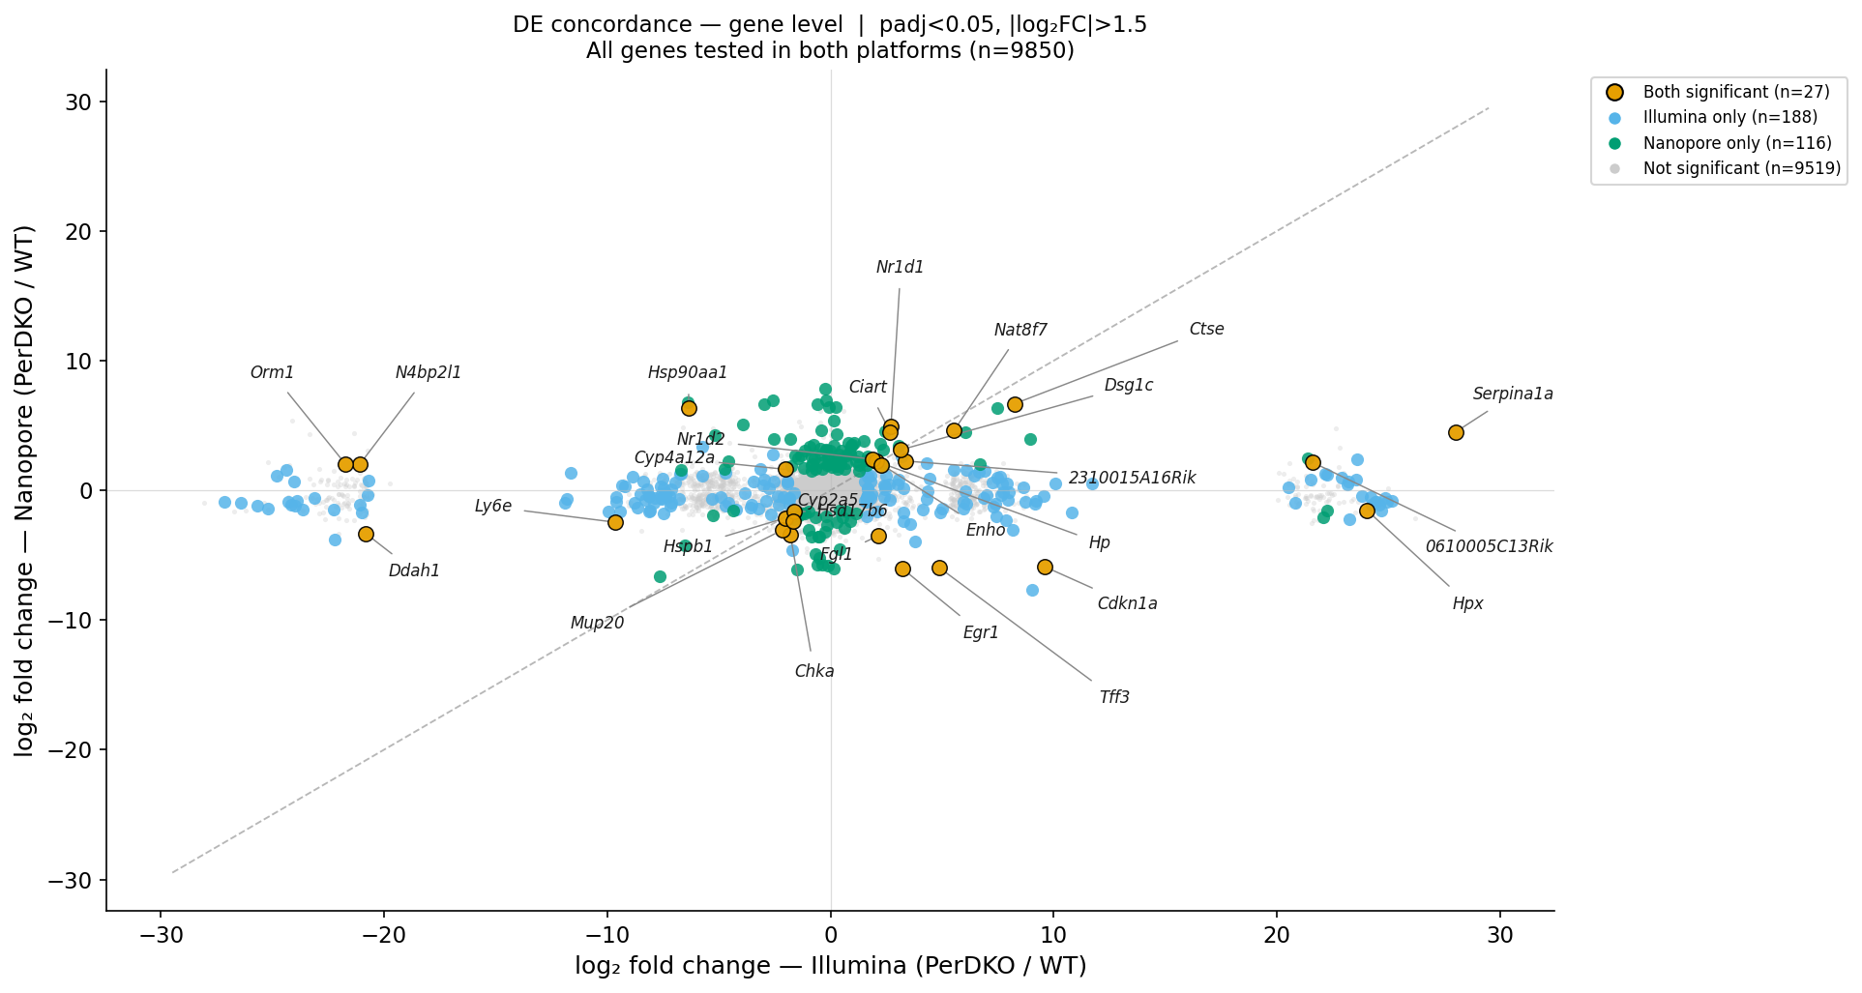
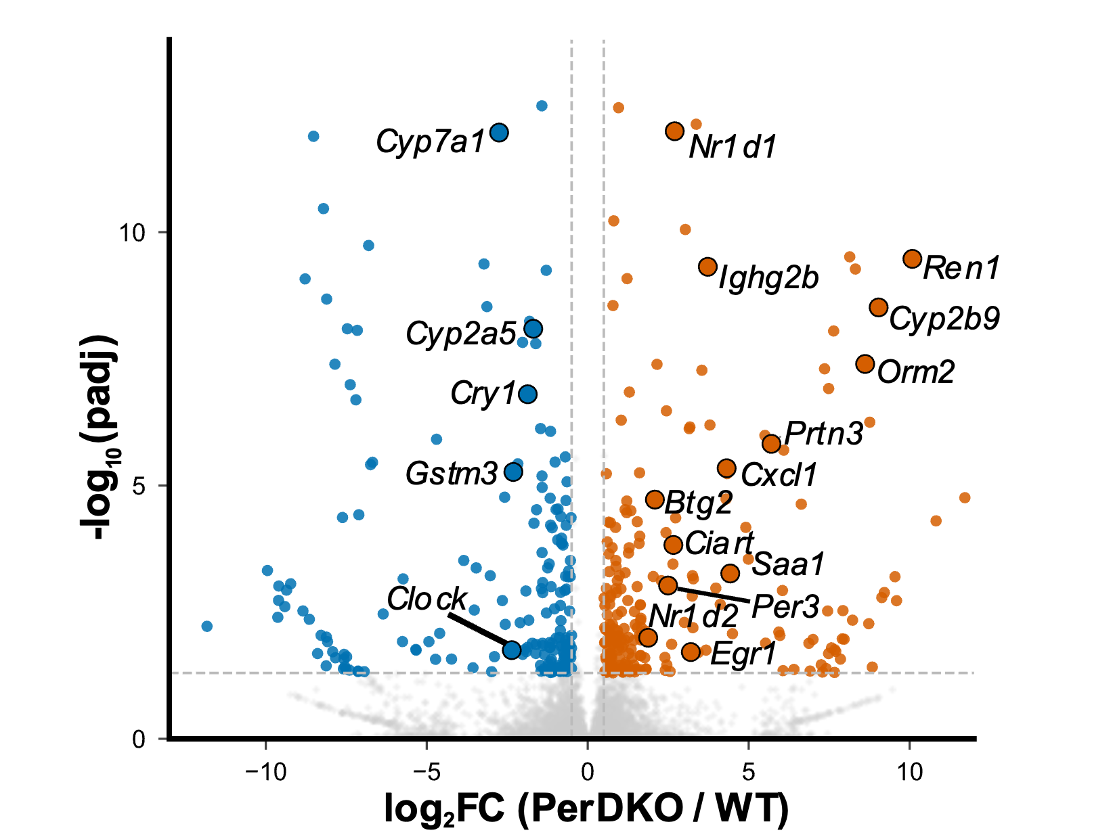
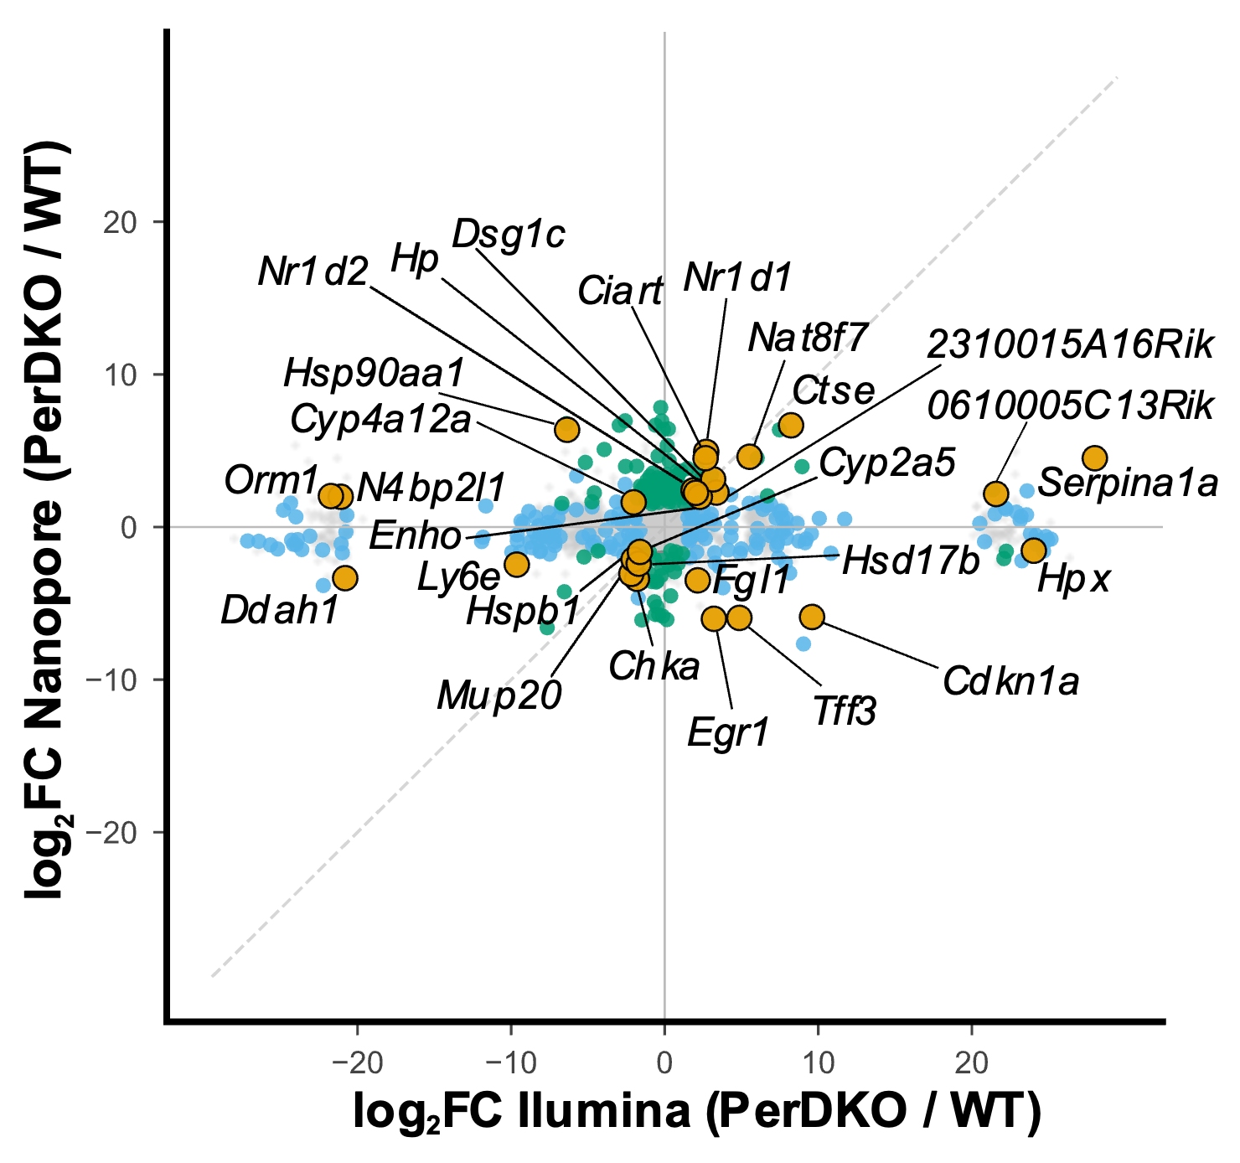
Baseline — original Salmon pipeline
OLD pipeline

Slide 5
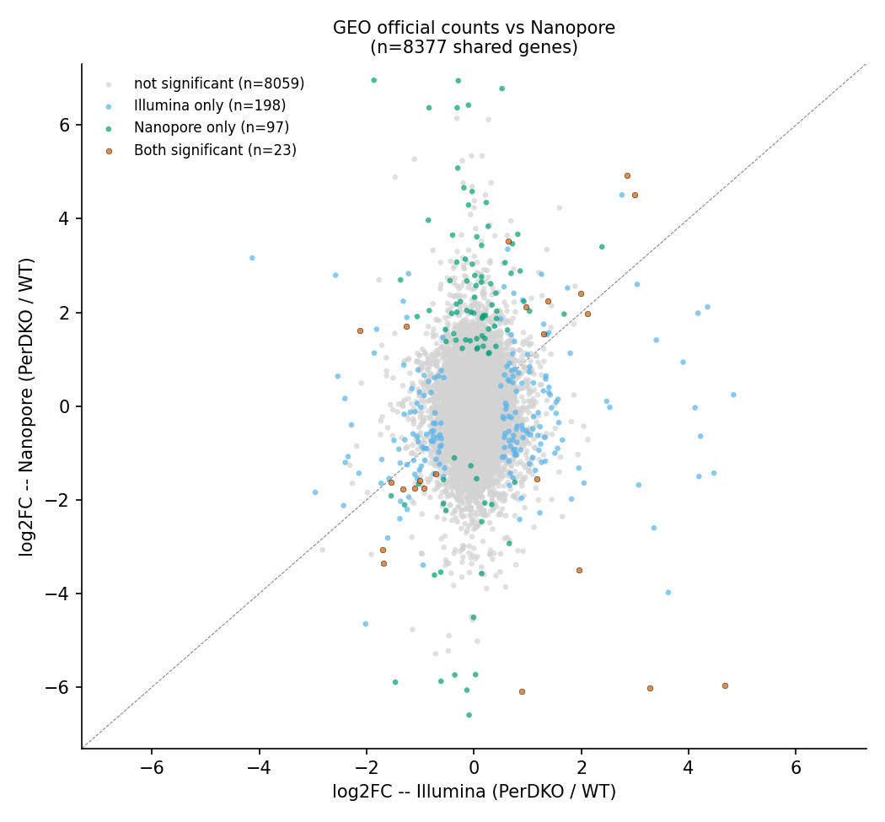
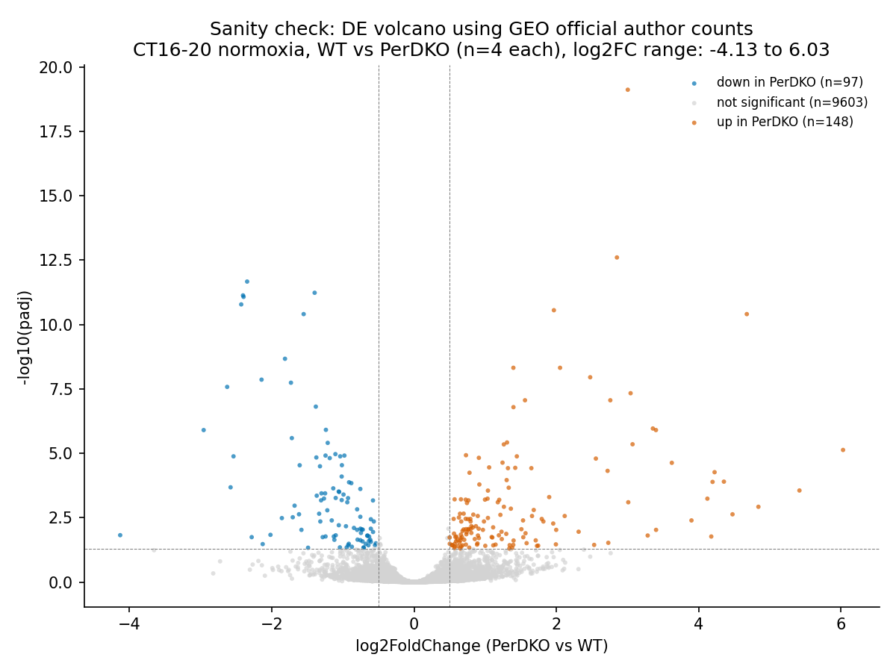
Sanity check — GEO official counts
Exploration

Slide 6
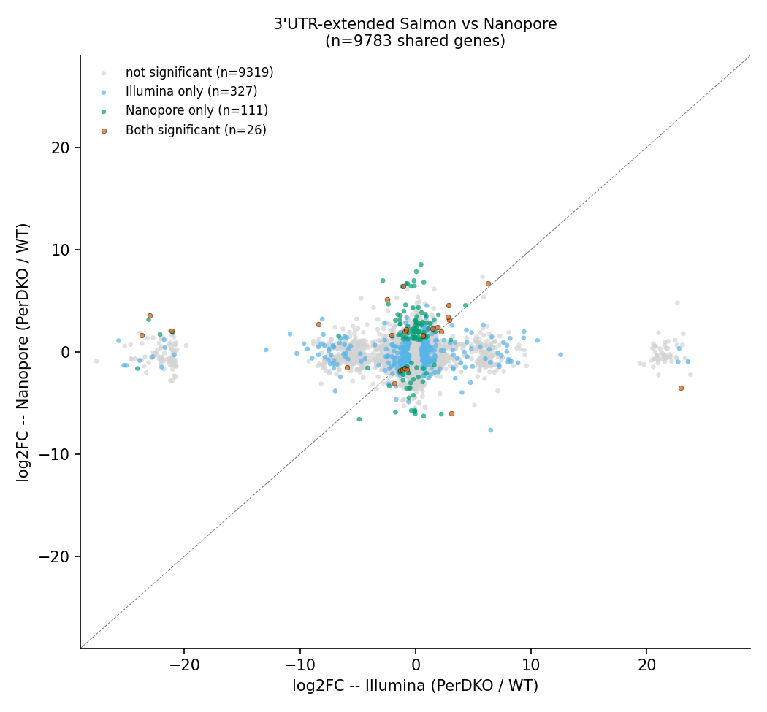
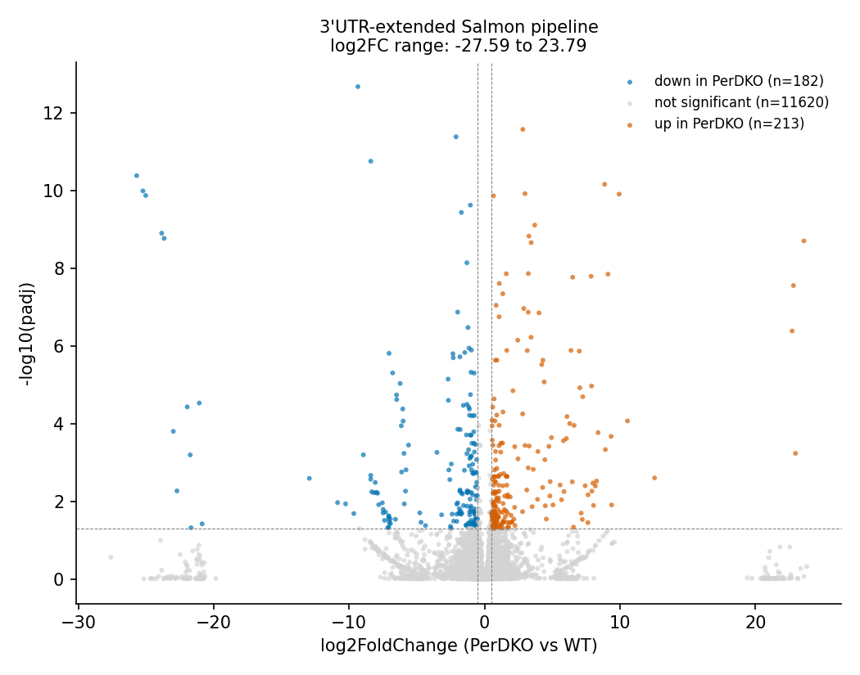
Step 1 — 3'UTR extension (still Salmon)
Exploration
From Salmon To STAR + htseq-count
The extended transcriptome GTF stretches every gene's annotated boundary 1000bp toward its 5' end and 100bp toward its 3' end (following Asher’s methods)

Slide 7
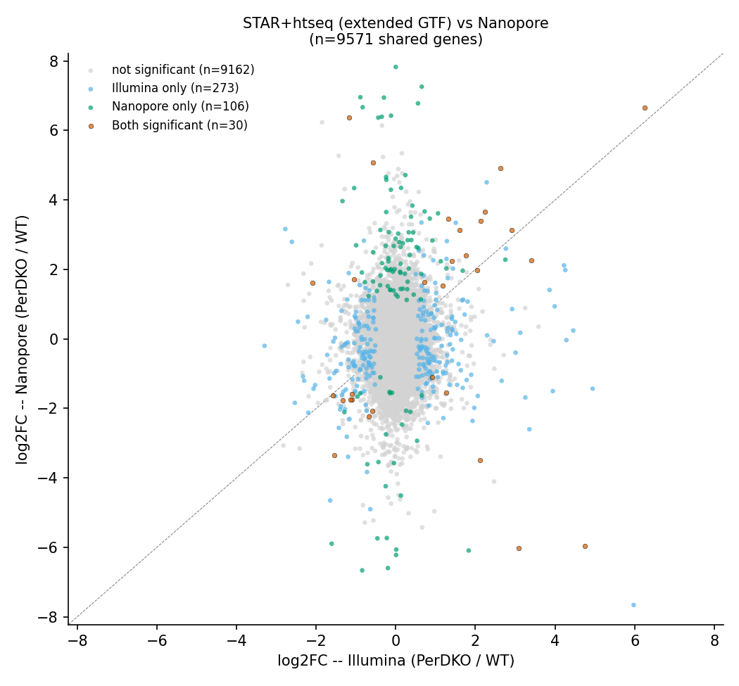
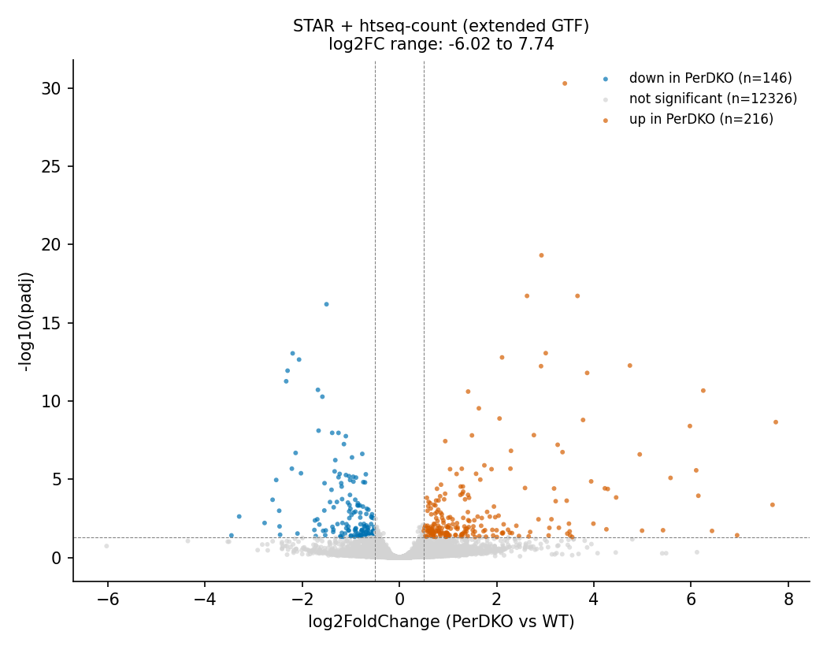
Step 2a — STAR + htseq-count (extended GTF)
Exploration
From Salmon To STAR + htseq-count
The extended transcriptome GTF stretches every gene's annotated boundary 1000bp toward its 5' end and 100bp toward its 3' end (following Asher’s methods)

Slide 8
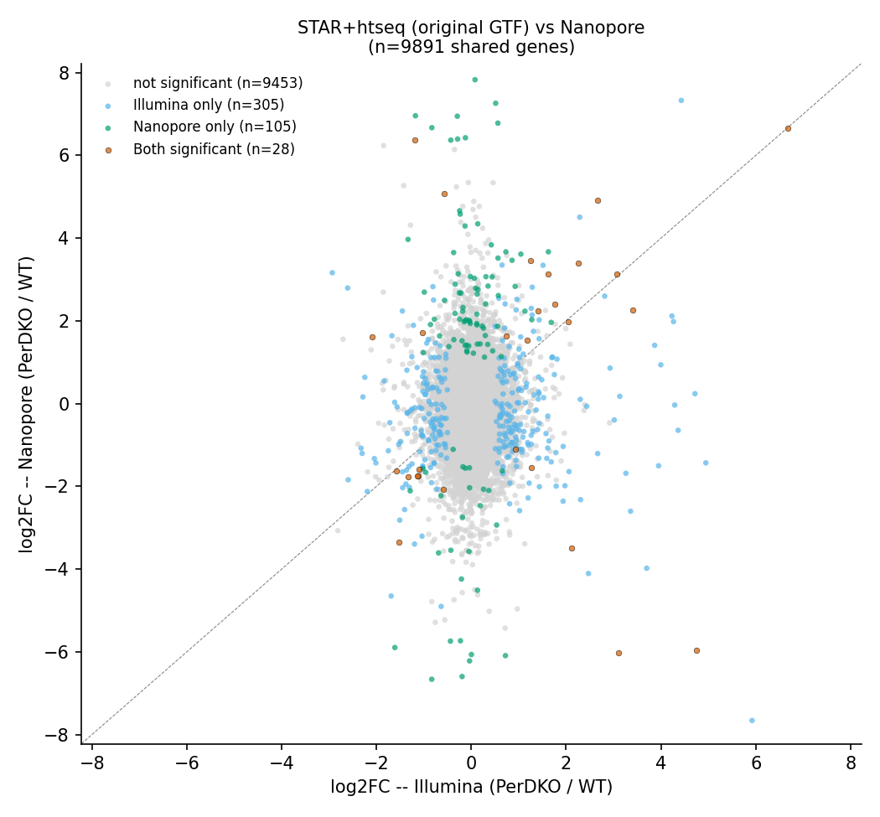
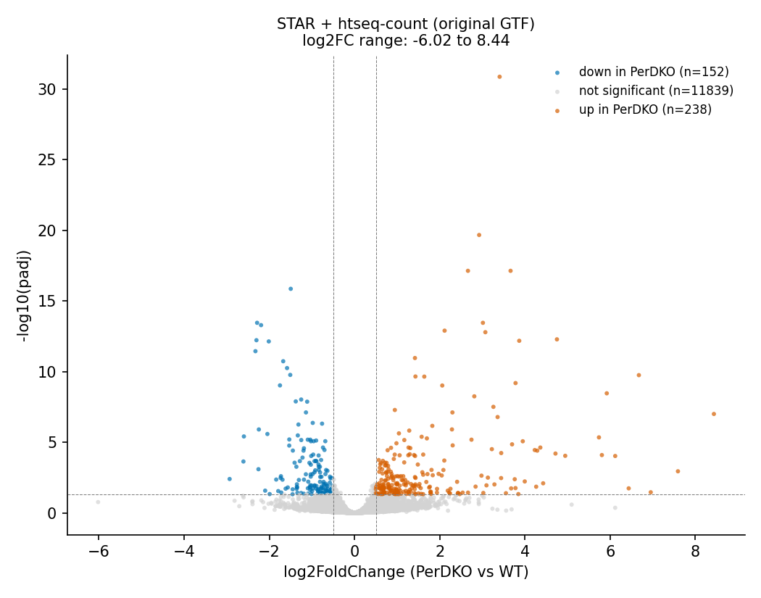
Step 2b — STAR + htseq-count (original GTF)
Exploration
From Salmon To STAR + htseq-count
We kept the ORIGINAL GTF because the read assignment quality itself got worse with the extension: 45.2% of reads assigned to a gene / 32.4% ambiguous with the extended GTF, versus 50.3% assigned / 26.7% ambiguous with the original. Stretching gene boundaries made neighboring genes' territories overlap more, so more reads became ambiguous between two extended regions instead of cleanly landing in one. The extension backfired on its own goal.

Slide 9
Splicing analysis: switching from Salmon+SUPPA to STAR+rMATS
NEW pipeline

Slide 10
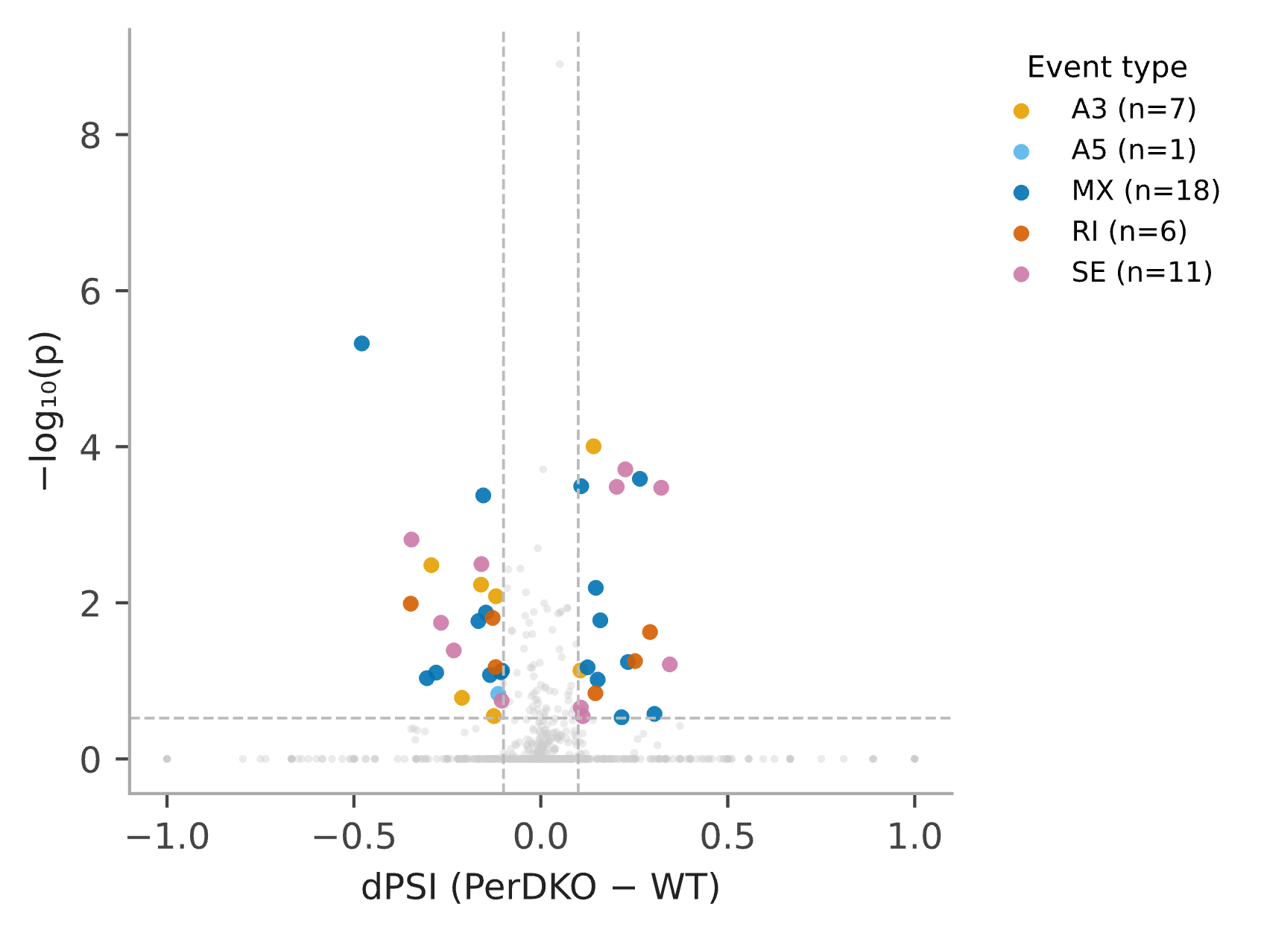
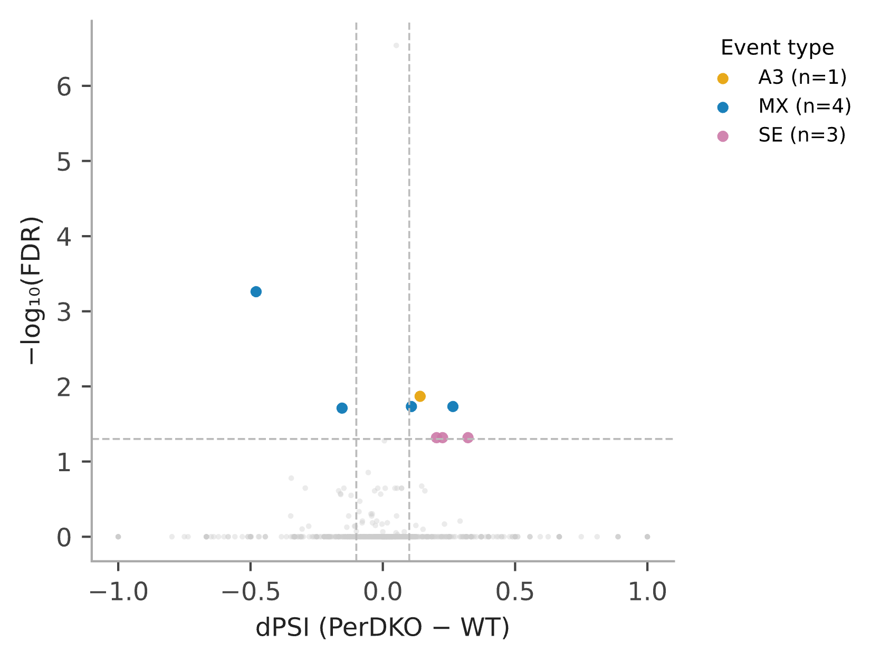
NEW pipeline
Figure 1. Alternative splicing, PerDKO vs WT, FDR < 0.05
Figure 2. Alternative splicing, PerDKO vs WT, p < 0.3
Volcano plot of differential splicing (rMATS-turbo, junction-spanning reads counted
directly from the STAR alignments) between PerDKO and WT liver. Each point is one
alternative splicing event. X-axis: dPSI (percent-spliced-in difference, PerDKO minus WT). Y-axis: -log10(FDR). Dashed lines mark the significance thresholds (|dPSI| > 0.1, FDR < 0.05), the stricter, multiple-testing-corrected threshold. Grey, not significant. Significant events (n = 8) are colored by event type: MX, mutually exclusive exons (dark blue, n = 4); SE, exon skipping (magenta, n = 3); A3, alternative 3' splice site (amber, n = 1). No A5 or RI events reach this threshold. rMATS does not call AF/AL (alternative first/last exon) events.
Same data and event-type colors as Figure 1, using the raw, uncorrected p-value threshold (|dPSI| > 0.1, p < 0.3) in place of the FDR cutoff. This threshold matches the one previously used for this dataset's Salmon+SUPPA2 splicing analysis, included here for direct comparison. Significant events (n = 43): MX (dark blue, n = 18); SE (magenta,
n = 11); A3 (amber, n = 7); RI, retained intron (orange-red, n = 6); A5, alternative 5’ splice site (light blue, n = 1). Of the annotated candidate events, only 1.9-17.4% (varying by event type) had sufficient junction-spanning read coverage to be testable at all, a consequence of MARS-seq's 3'-end sequencing bias.

Slide 11
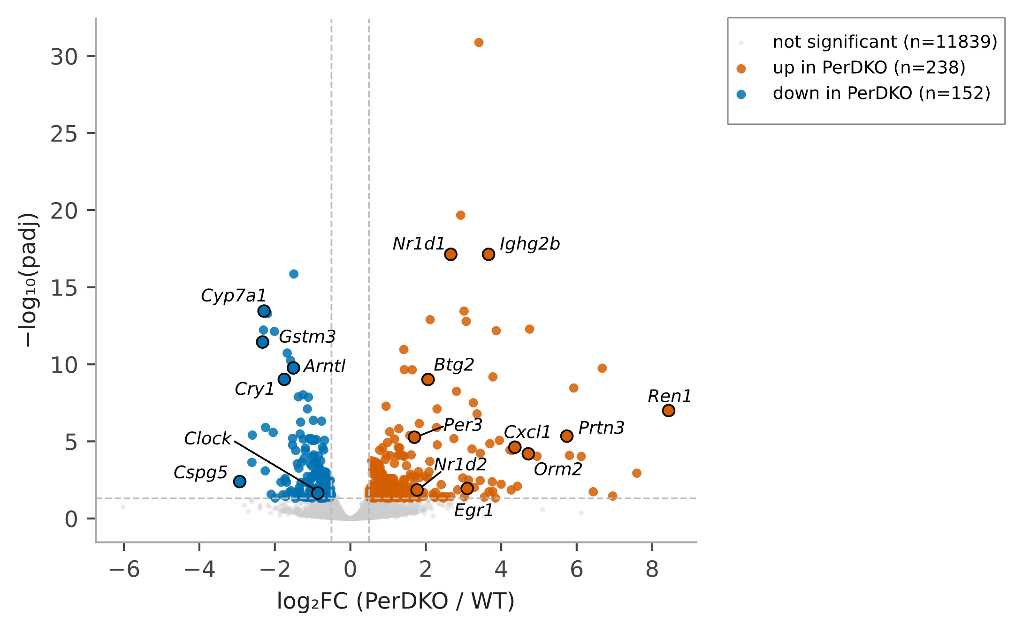
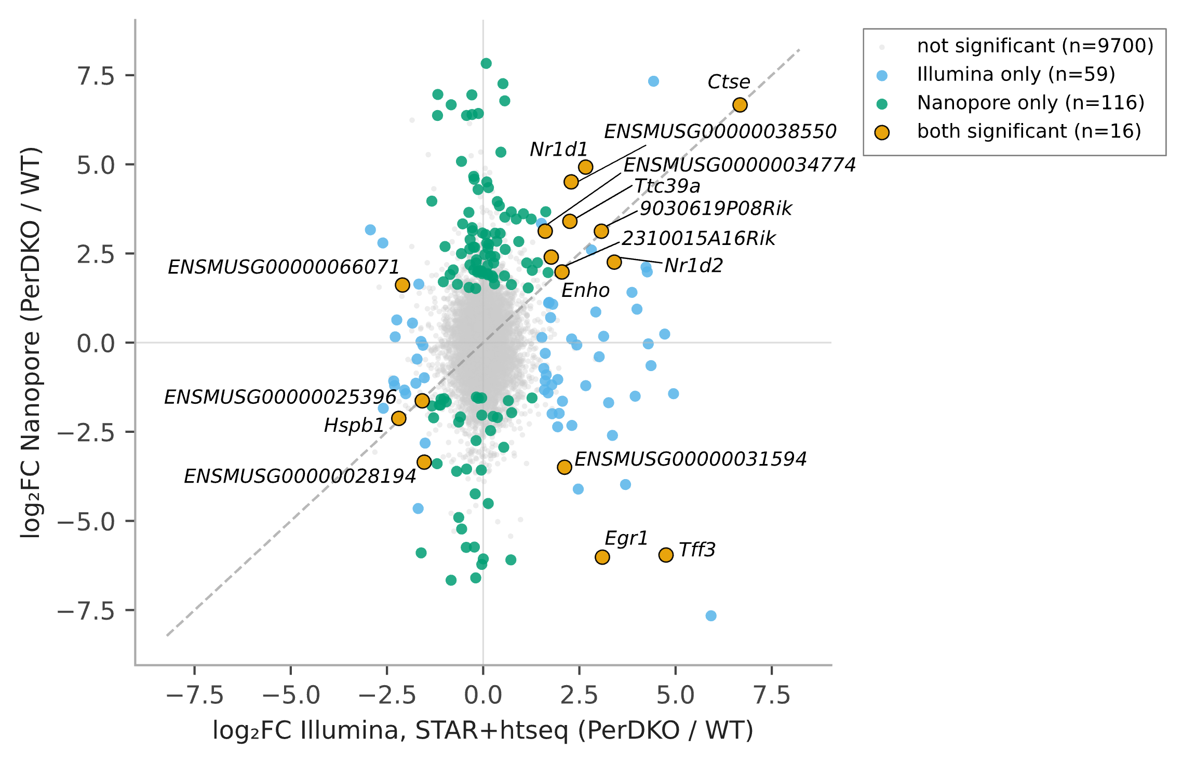
NEW pipeline
Concordance with Nanopore: 16 overlapping genes, 12 same direction, 4 opposite.
Old Salmon-based version had 27 overlapping genes. The drop to 16 lines up with what we already suspected, Salmon's inflated spread was likely pushing some genes over the significance threshold artificially. The tighter STAR+htseq range gives a smaller but more trustworthy overlap.
Figure 3. Differential gene expression, PerDKO vs WT (gene-level)
Figure 4. Overlap with an independent Nanopore dataset, differential expression (gene-level)
Volcano plot of differential expression between PerDKO and WT liver, gene-level DESeq2
analysis (Wald test, single contrast; htseq-count is gene-level only, no transcript
resolution). Each point is one gene. X-axis: log2 fold change (PerDKO / WT). Y-axis:
-log10(adjusted p-value). Dashed lines mark the significance thresholds (|log2FC| > 0.5,
padj < 0.05). Orange, significantly upregulated in PerDKO (n = 238); blue, significantly
downregulated (n = 152); grey, not significant. 15,967 genes were tested (genes with fewer
than 10 total reads across all 8 samples were excluded beforehand). Labeled points are
circadian and clock-related genes from a curated list, shown where significant.
Overlap between genes significantly differentially expressed in the PerDKO Illumina dataset and genes significantly differentially expressed in an independent Nanopore long-read dataset (same PerDKO vs WT liver comparison, same laboratory), gene level, both platforms thresholded at padj < 0.05 and |log2FC| > 1.5. 16 genes are significant in both datasets (orange, labeled), out of 59 significant in the Illumina dataset only (blue) and 116 significant in the Nanopore dataset only (green), against a background of 9,891 genes tested in both platforms (grey).

Slide 12
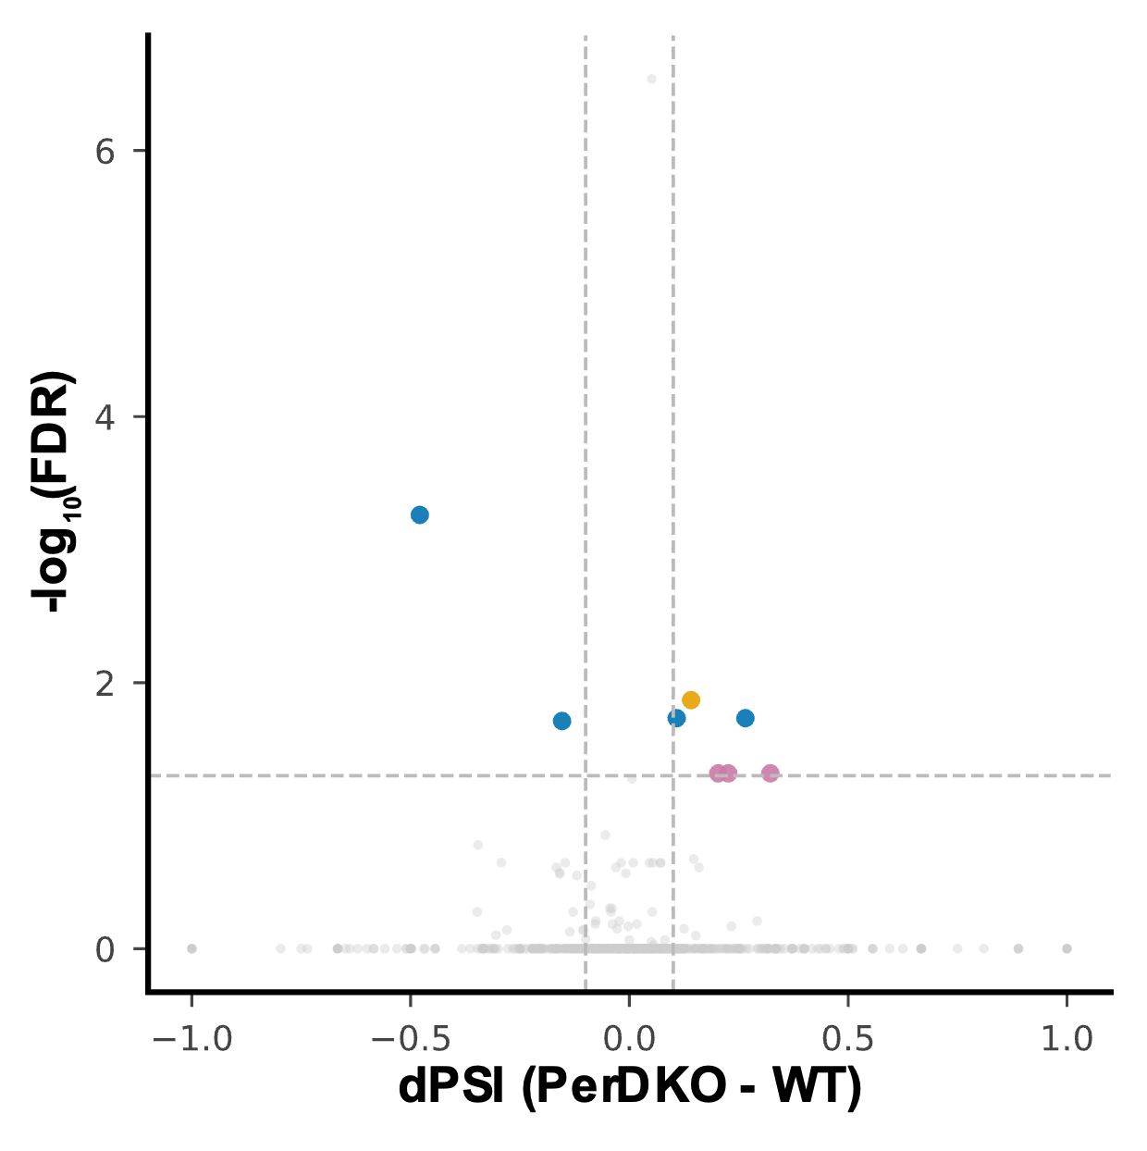
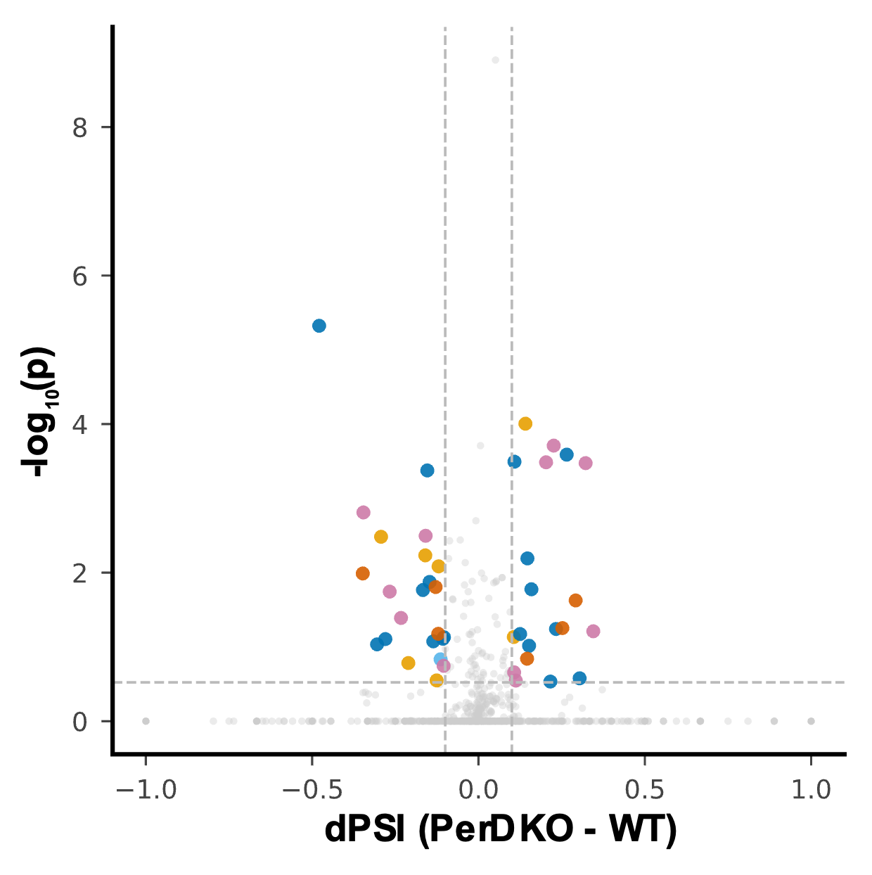
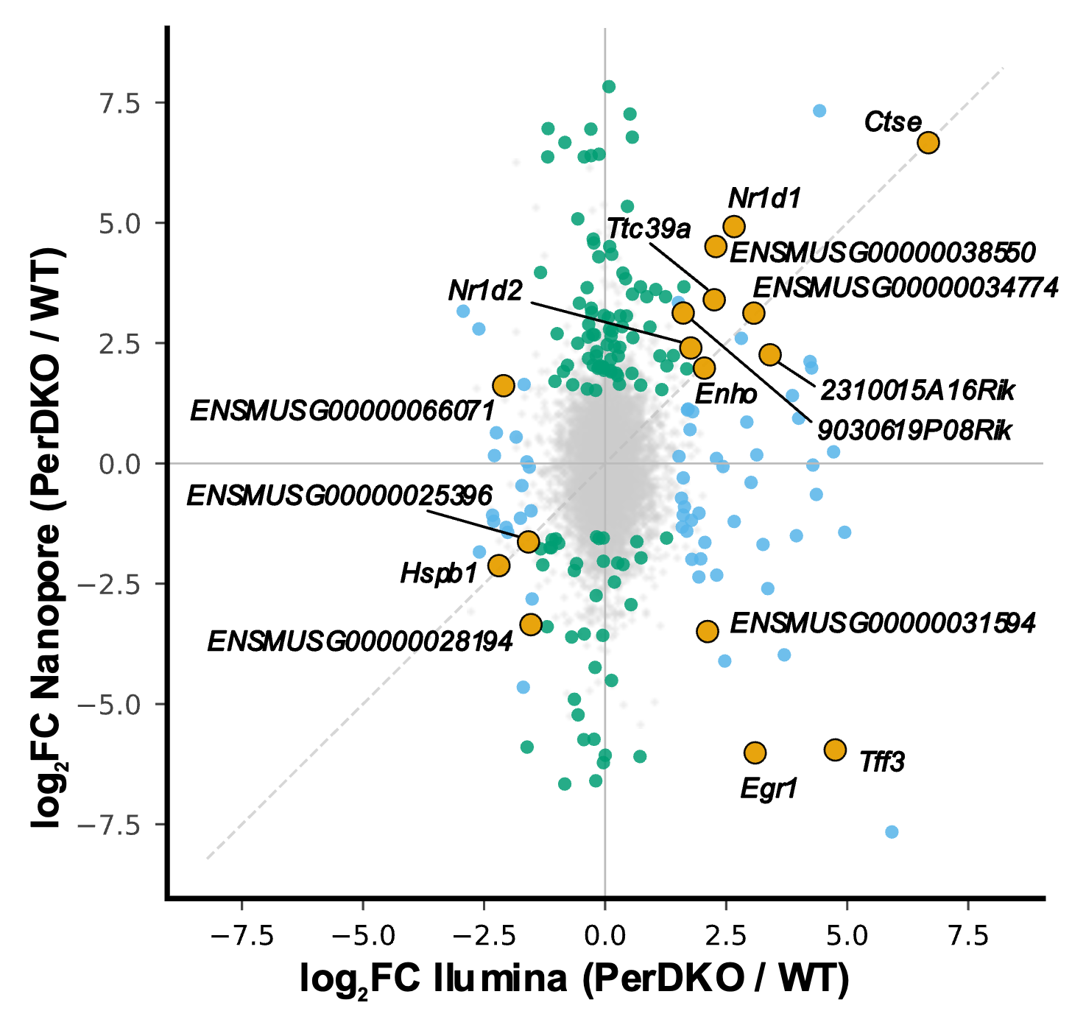
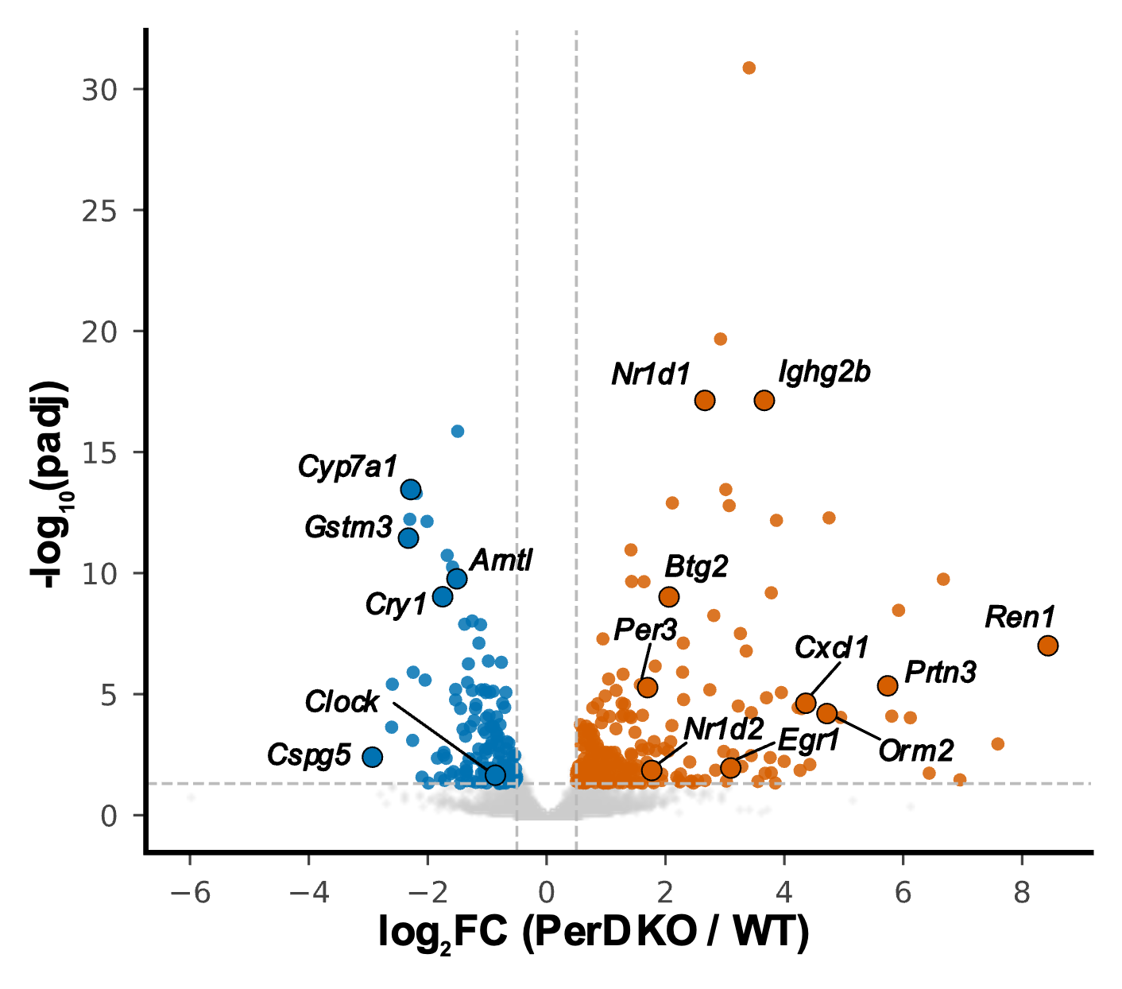
Small version

Slide 13
GSE133398 – Nick Webster SRSF3 Illumina x Nanopore
29/06/2026 to 14/07/2026

Slide 14
Details
Splicing threshold updated to p<0.05 (was p<0.3). This drops significant splicing events from 2,431 to 84 across all 7 event types (SE=30, AF=18, RI=12, A5=11, A3=8, MX=4, AL=1).
Both DE options are built, gene-level (A) and transcript-level with stageR (B):
Option A: 1,595 significant genes (840 up, 755 down)
Option B: 998 significant genes (stage 1), 950 significant transcripts (stage 2)
Nanopore overlap, both options (pie charts):
DE overlap: 37 genes (Option A) vs 19 genes (Option B)
Splicing overlap: 3 genes (at the updated p<0.05)

Slide 15
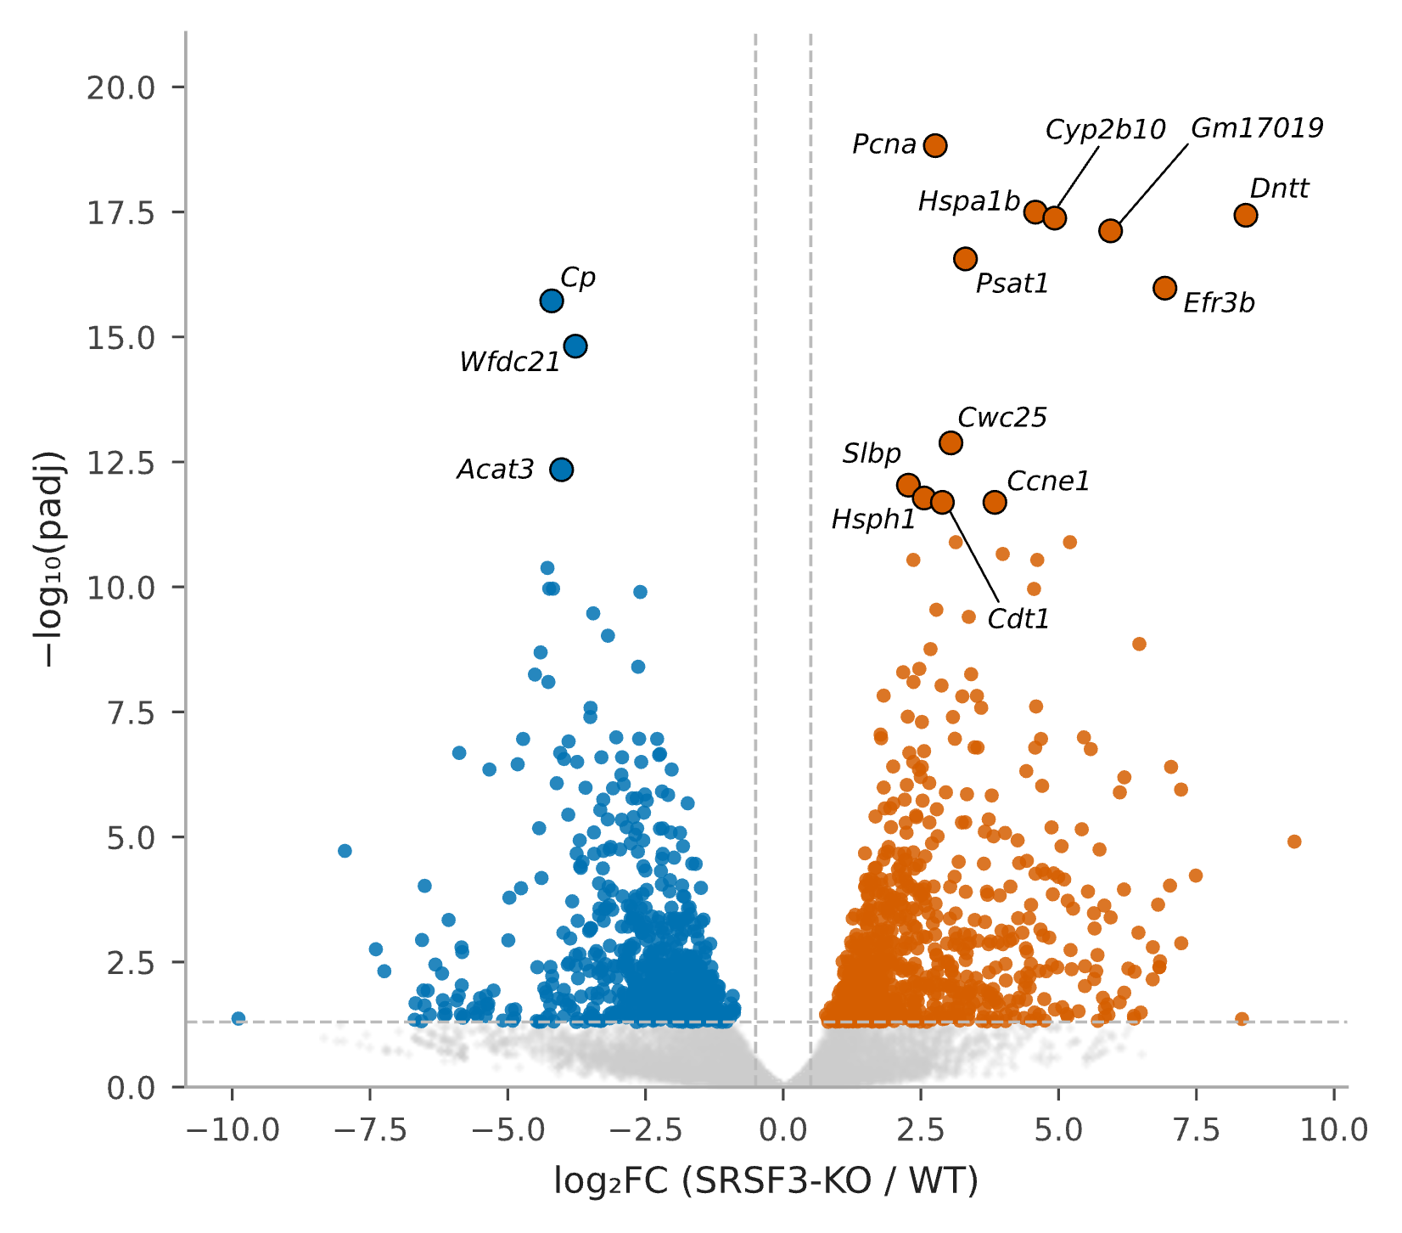
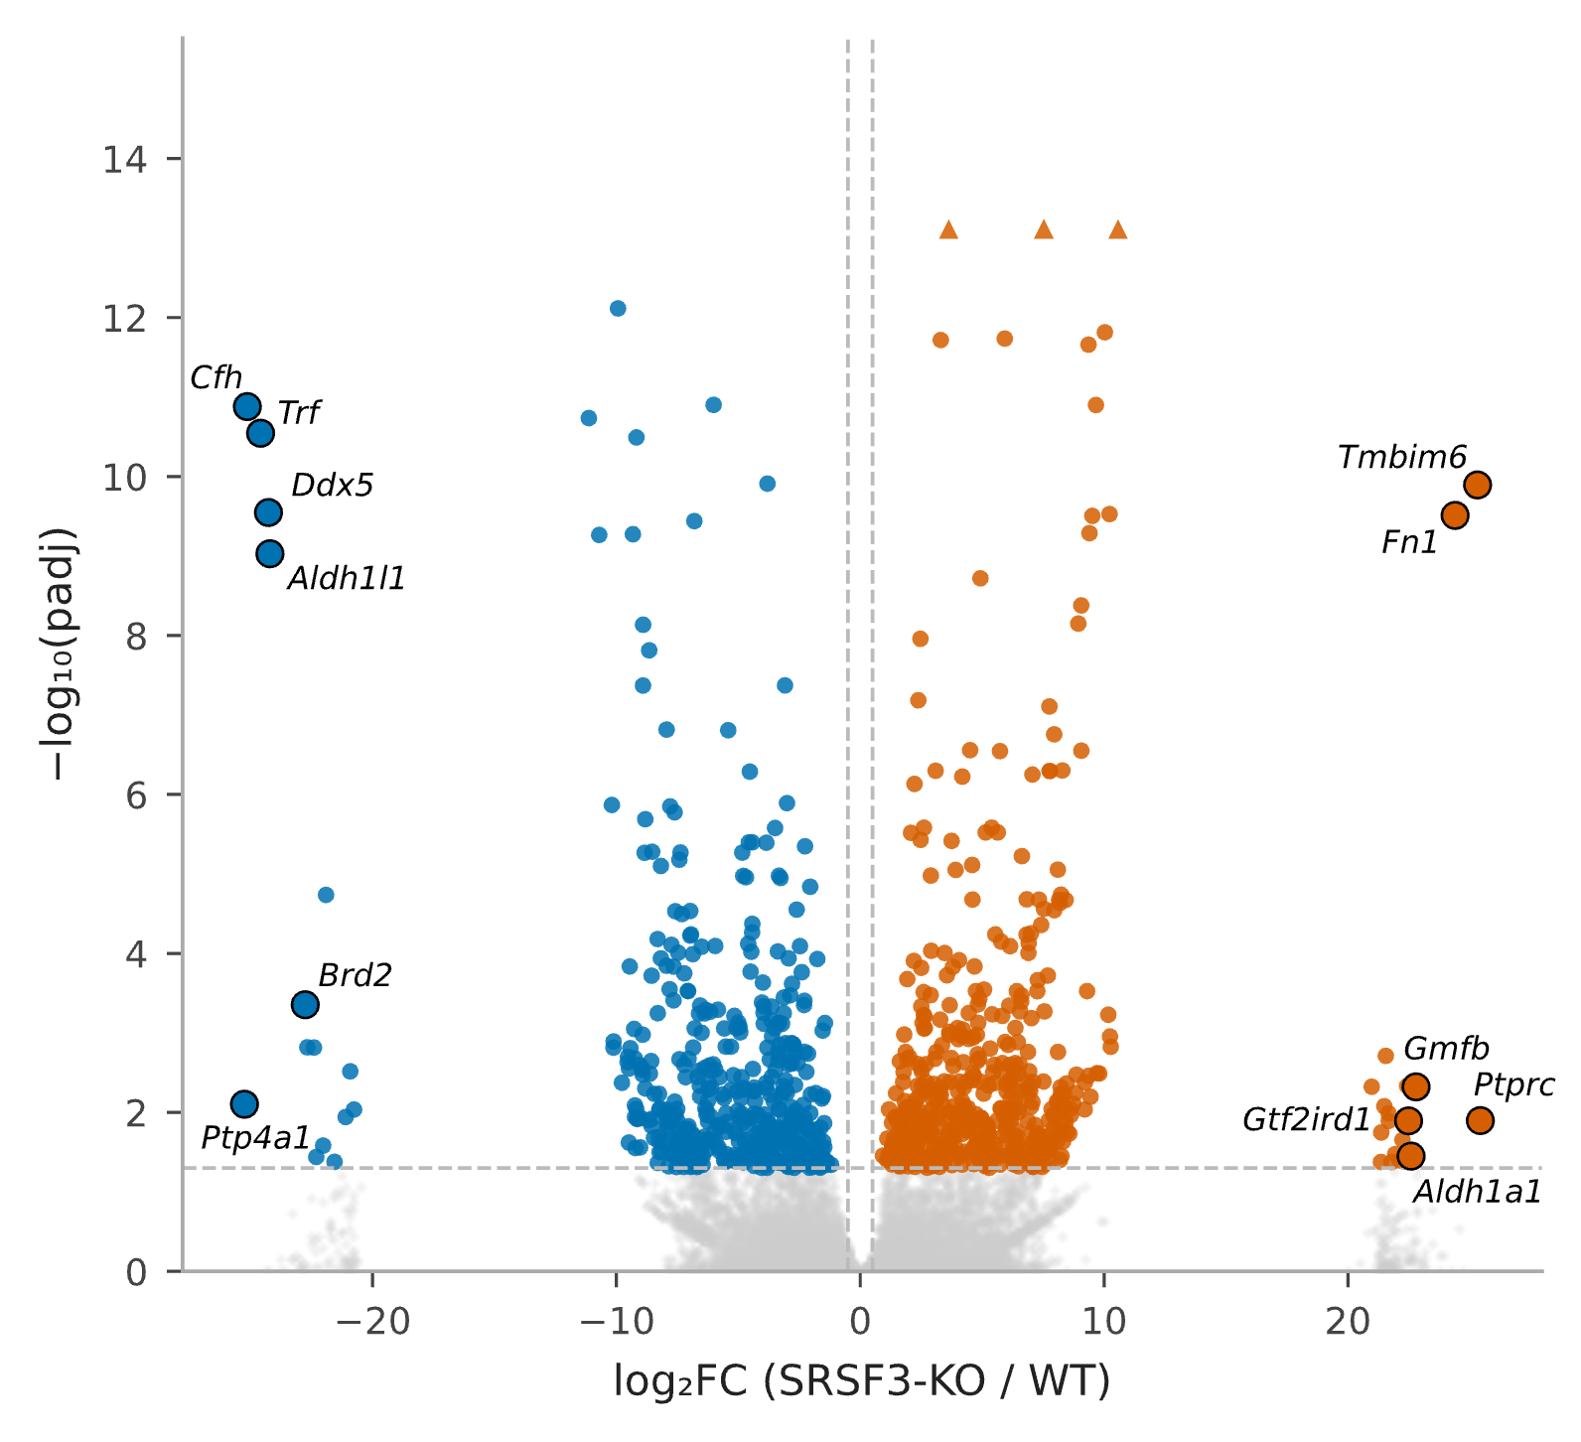
DE options, at gene-level and at transcript level
Figure 1. Differential gene expression, SRSF3-KO vs control (gene-level)
Figure 2. Differential gene expression, SRSF3-KO vs control
(transcript-level, two-stage)
Volcano plot of differential expression between SRSF3-knockout and control hepatocytes, gene-level DESeq2 analysis (transcript counts aggregated to one value per gene before testing). Each point is one gene. X-axis: log2 fold change (SRSF3-KO / control). Y-axis: -log10(adjusted p-value). Dashed lines mark the significance thresholds (|log2FC| > 0.5, padj < 0.05). Orange, significantly upregulated in SRSF3-KO (n = 840); blue, significantly downregulated (n = 755); grey, not significant. Labeled points are the 15 most significant genes by adjusted p-value.
Volcano plot of the same comparison using a transcript-level, two-stage testing approach (stageR): individual transcripts are tested first; a gene-level screening step then asks whether any transcript of a gene changed, followed by transcript-level confirmation within screened genes. This approach can detect isoform-specific changes that are diluted when transcript counts are summed to the gene level before testing. Axes and thresholds as in Figure 1. 998 genes significant at the screening stage; 950 individual transcripts confirmed significant. Triangles mark genes with an adjusted p-value of exactly zero (below numerical precision), plotted at a fixed ceiling above the highest measurable value rather than at their true (unplottable) height. Labeled points are the 6 most upregulated and 6 most downregulated significant genes by fold change.

Slide 16
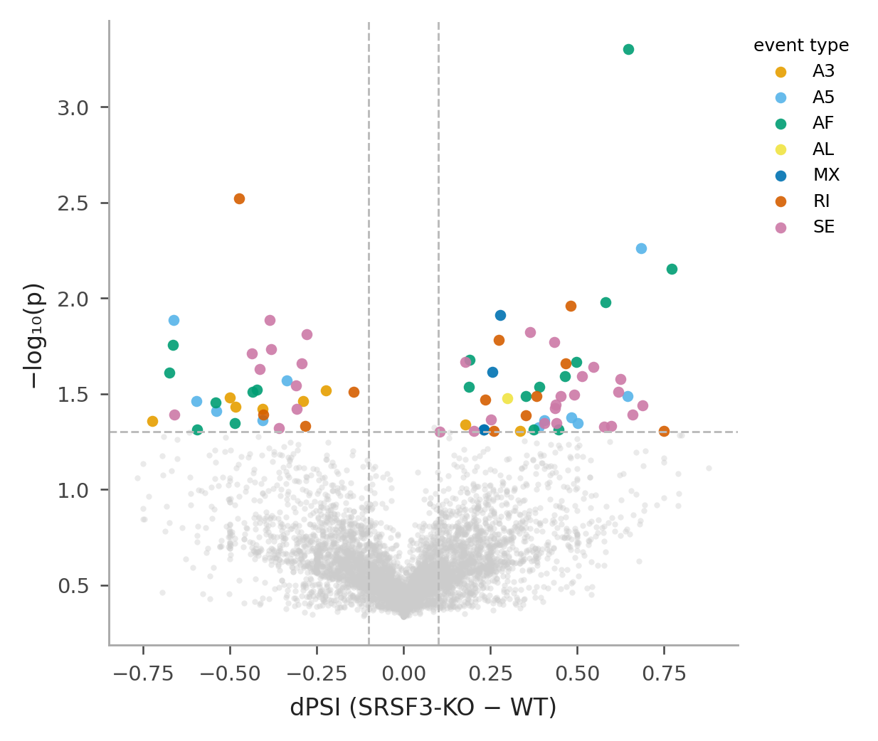
Splicing
Figure 3. Alternative splicing, SRSF3-KO vs control
Volcano plot of differential splicing (SUPPA2, empirical method) between SRSF3-KO and control hepatocytes.
Each point is one alternative splicing event. X-axis: dPSI (percent-spliced-in difference, SRSF3-KO minus control). Y-axis: -log10(p-value). Dashed lines mark the significance thresholds (|dPSI| > 0.1, p < 0.05). Grey, not significant. Significant events (n = 84) are colored by event type: SE, exon skipping (magenta, n = 30);
AF, alternative first exon (teal, n = 18); RI, retained intron (orange-red, n = 12); A5, alternative 5' splice site (light blue, n = 11); A3, alternative 3' splice site (amber, n = 8); MX, mutually exclusive exons (dark blue, n = 4); AL, alternative last exon (yellow, n = 1).

Slide 17
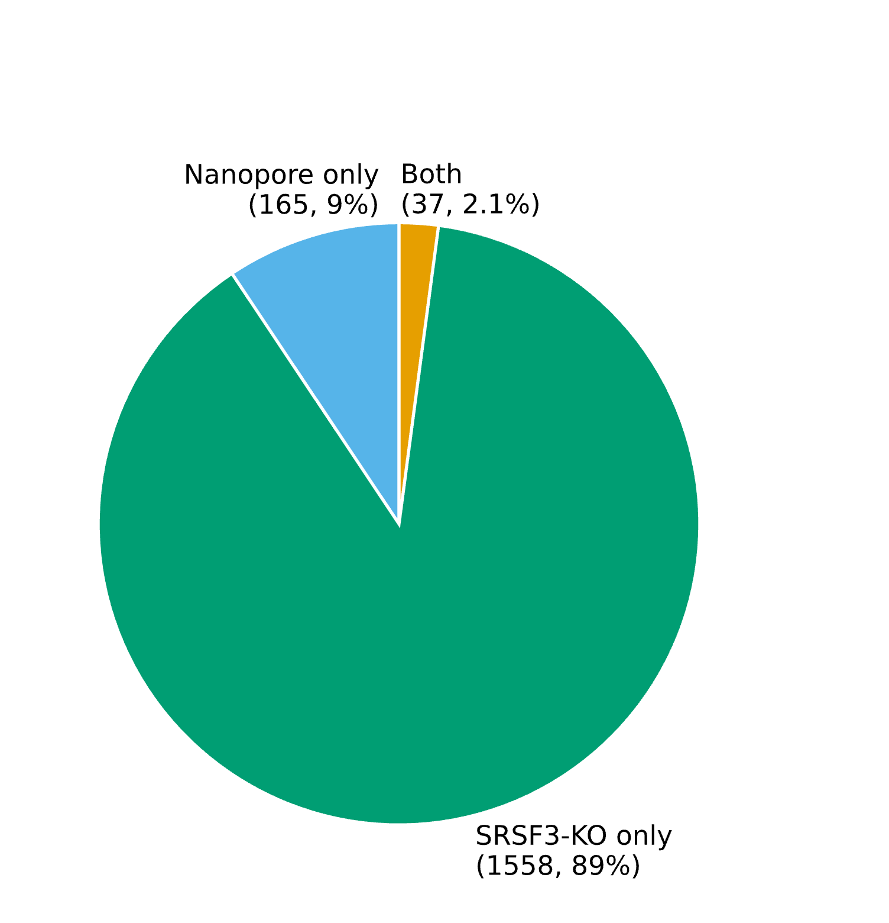
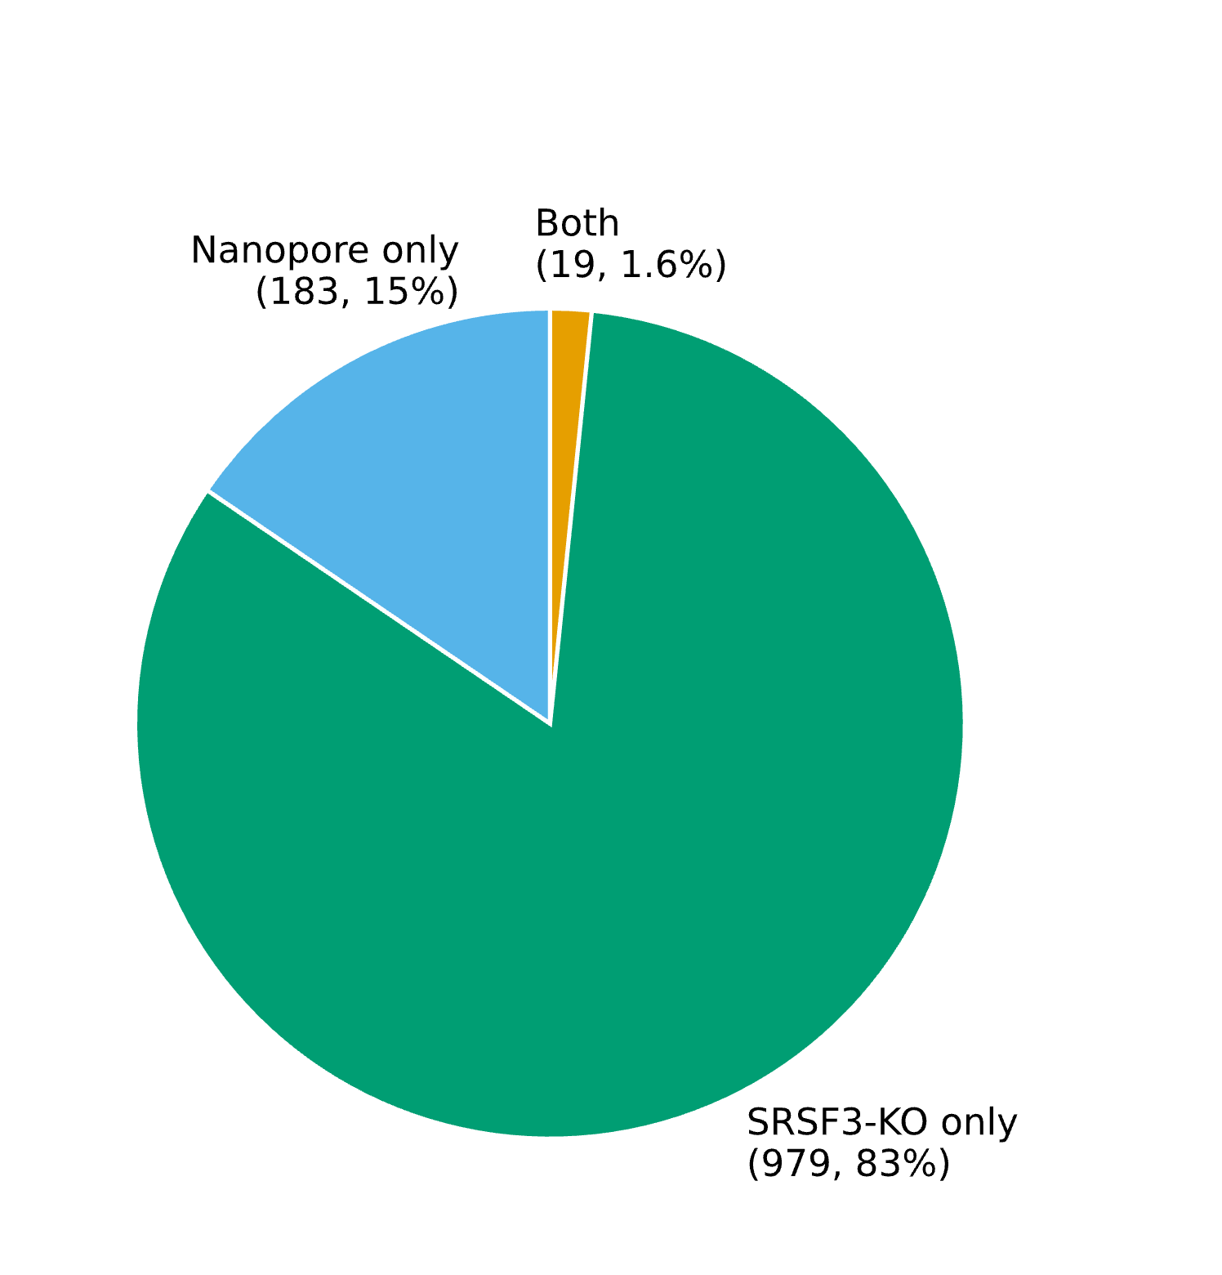
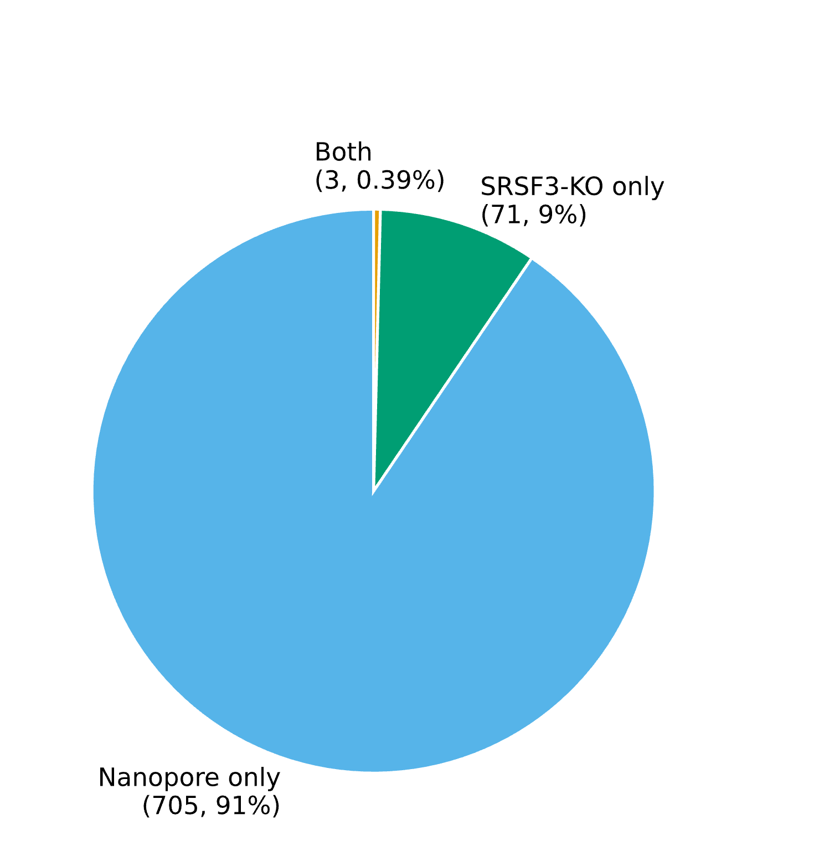
Pie charts
Figure 4. Overlap with an independent Nanopore dataset, differential expression (gene-level)
Figure 5. Overlap with an independent Nanopore dataset, differential expression
Figure 6. Overlap with an independent Nanopore dataset, alternative splicing
Overlap between genes significantly differentially expressed in the SRSF3-KO Illumina dataset (gene-level analysis, Figure 1) and genes significantly differentially expressed in an independent Nanopore long-read dataset (Per1/2-DKO vs wild-type liver, same laboratory). 37 genes are significant in both datasets, out of 165 significant in the Nanopore dataset only and 1,558 significant in the SRSF3-KO dataset only.
Same comparison as Figure 4, using the transcript-level, two-stage significant gene list (Figure 2) in place of the gene-level list. 19 genes overlap, out of 183 significant in the Nanopore dataset only and 979 significant in the SRSF3-KO dataset only.
Overlap between genes with at least one significant splicing event in the SRSF3-KO Illumina dataset (Figure 3) and genes with at least one significant splicing event in the Nanopore dataset (same significance thresholds applied to both: |dPSI| > 0.1, p < 0.05). 3 genes overlap, out of 705 significant in the Nanopore dataset only and 71 significant in the SRSF3-KO dataset only.

